Slide 1
MetroGIS Coordinating Committee
January 26, 2023

Slide 2
MetroGIS Coordinating Committee
January 26, 2023
1 ) Call to Order
2 ) Approve Today’s Meeting Agenda
3 ) Approve Minutes from last meeting on December 8, 2022

Slide 3
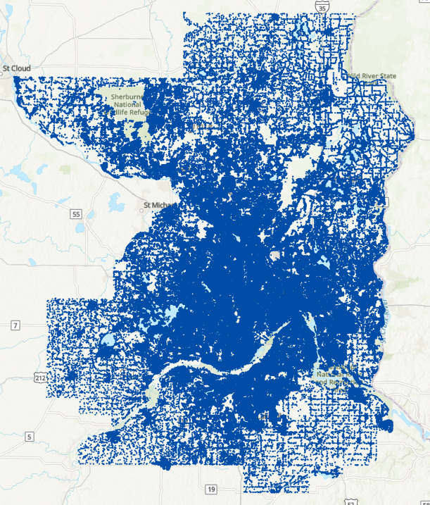
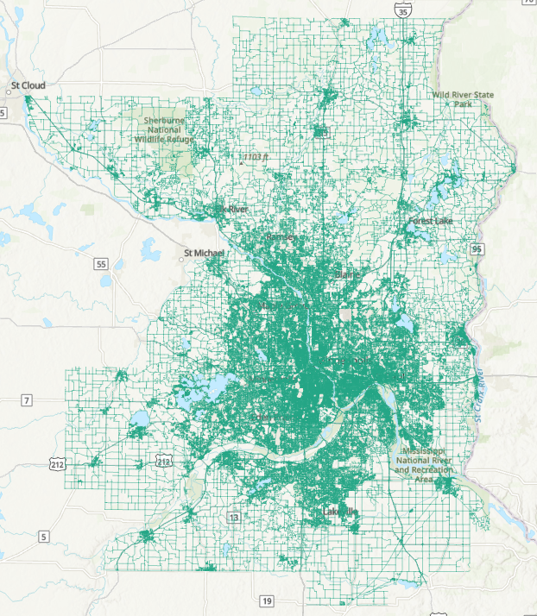
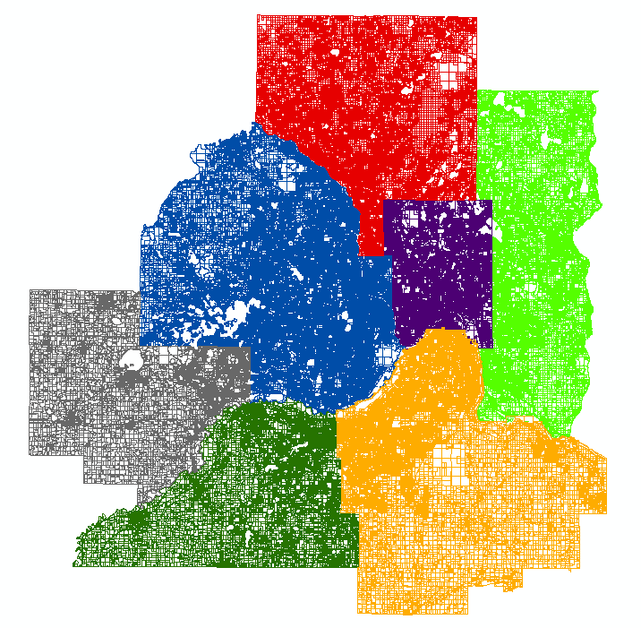
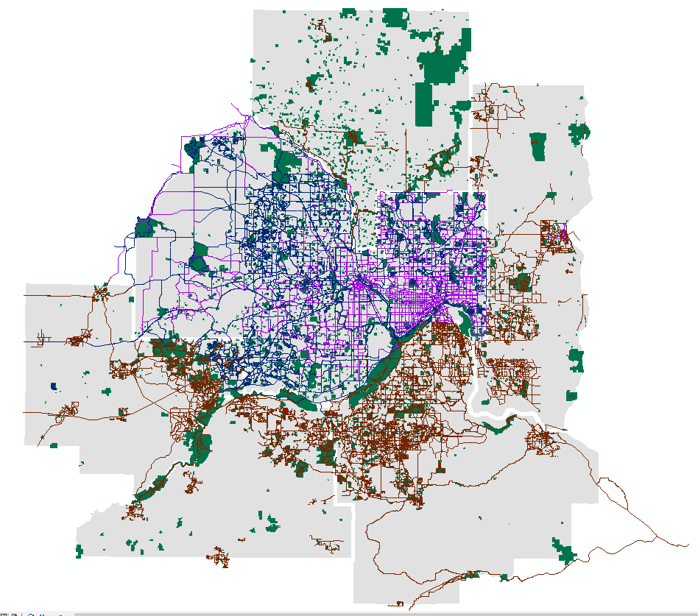
Why we are here:
#1 - Regional Datasets
Stable, continued, on-going, maintenance of the regional datasets
Regional datasets remaining high quality and accurate
Ease of access and reliability of the regional datasets
< Parcels
Parks/Trails >
Address points
Road centerlines

Slide 4
Why we are here:
#1 - Regional Datasets
Stable, continued, on-going, maintenance of the regional datasets
Regional datasets remaining high quality and accurate
Ease of access and reliability of the regional datasets
#2 – Meet the needs of the participants
A place to communicate, discuss, and explore ideas
A place to ask for what you want and need
#3 – Take on projects appropriate to the collaborative
Projects and initiatives to meet our shared needs
< Parcels
Parks/Trails >
Address points
Road centerlines

Slide 5
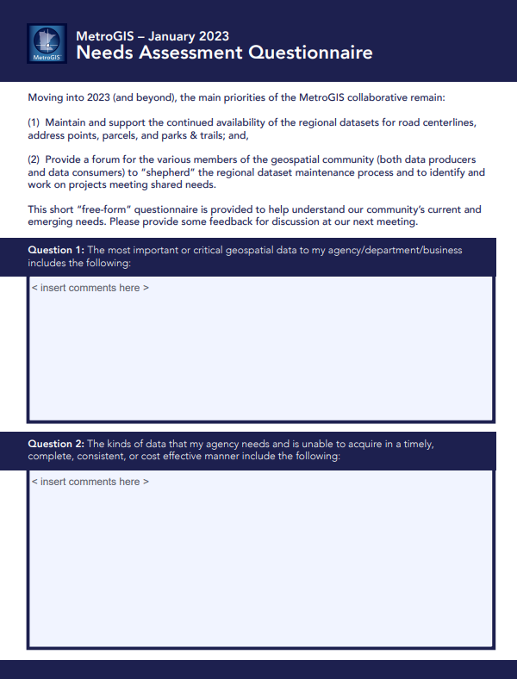
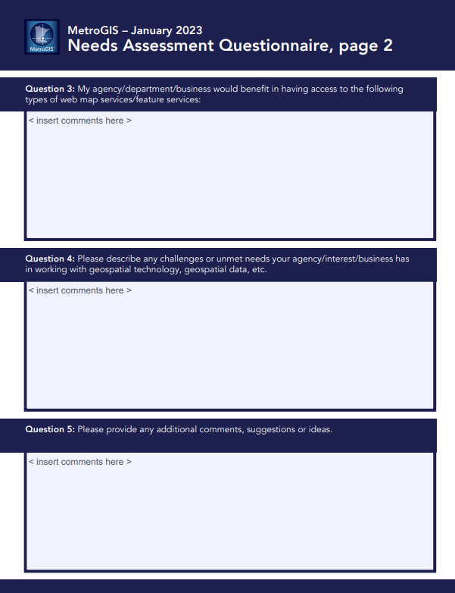
4) Needs Assessment

Slide 6
Question 1: The most important or critical geospatial data to my agency/department/business includes the following:
Regional road centerline (GAC compliant)
Regional address points (GAC compliant)
Regional parcel data
Regional CTU/Administrative boundaries
Regional parks and trails data
Aerial imagery
Regional water features (lakes/rivers)
Regional MSAG community boundaries
Regional emergency service boundaries
Service areas
PSAPs
Emergency response areas
Permit/Inspection System
Utility billing data
Critical infrastructure
Water, storm, sewer lines
Fiber
Demographic data
Crime statistics
Sidewalk data
Roads with bike lanes
Grade separated multi-mode paths
LIDAR
Elevation data

Slide 7
Question 2: The kinds of data that my agency needs and is unable to acquire in a timely, complete, consistent, or cost-effective manner include the following:
Accurate addresses in multi-address parcels and complete sub-address data
Standardized data outside of the
10 County Metro region
Community service sites
(day care sites, food access sites)
Landmark data
Critical infrastructure
Fiber optic networks
Power line corridors
High-accuracy boundaries showing where city/county/state road jurisdictions begin and end

Slide 8
Question 3: My agency/department/business would benefit in having access to the following types of web map services/feature services:
Aerial imagery
Parks and trails
Jurisdictional Road Boundaries
Sidewalk data
Hydrants
AEDs (Defibrillators)
Regionwide Census/demographic data service (block/block group/tract)
Classified LIDAR data
Reliable 3D mapping
LIDAR derivatives
Updated and aligned boundaries
Critical infrastructure
Road centerlines
Water features and water access points
Grade-separated multi-modal paths

Slide 9
Question 4: Please describe any challenges or unmet needs your agency/interest/business has in working with geospatial technology, geospatial data, etc.
Acquiring/maintaining skills with ever-changing technology
Moving from ArcMap to ArcGIS Pro
Encouraging more use of online (ArcGIS Online) resources instead of printed maps/PDFs
Having time/resources/internal support to maintain high quality data
Maintaining topology with other jurisdictions (boundary issues)

Slide 10
Question 4: Please describe any challenges or unmet needs your agency/interest/business has in working with geospatial technology, geospatial data, etc.
Address accuracy and consistency between county data producer road centerline and address point data
Timeliness/frequency of updates by data producers to the regional datasets
Build out of consistently formatted, sub-address coverage in the regional address points
Edge-matching of data between metro data producers and their neighboring counties
Consistency in data producer use of GAC Location Description attribute
Getting local, authoritative data into external platforms (such as ESRI, Google, HERE, etc.) for data consistency with third party apps and geocoding services that rely on these platforms
Address and road data flows/processes between cities and county GIS departments
(data lifecycle models & supporting info)

Slide 11
Question 4: Please describe any challenges or unmet needs your agency/interest/business has in working with geospatial technology, geospatial data, etc.
Maintaining topological consistency across data layers
Automating geospatial applications and workflows
Indoor location identification, including geo-referenced building floor plans and the means to estimate floor level within multi-story buildings given a vertical z-axis coordinate
Consistent method for reporting/tracking data update requests with data producer organizations

Slide 12
5) 2023 Work Plan Project Updates

Slide 13
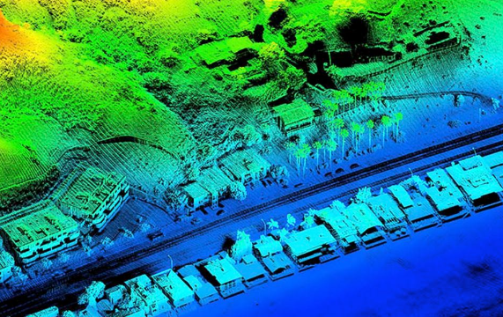
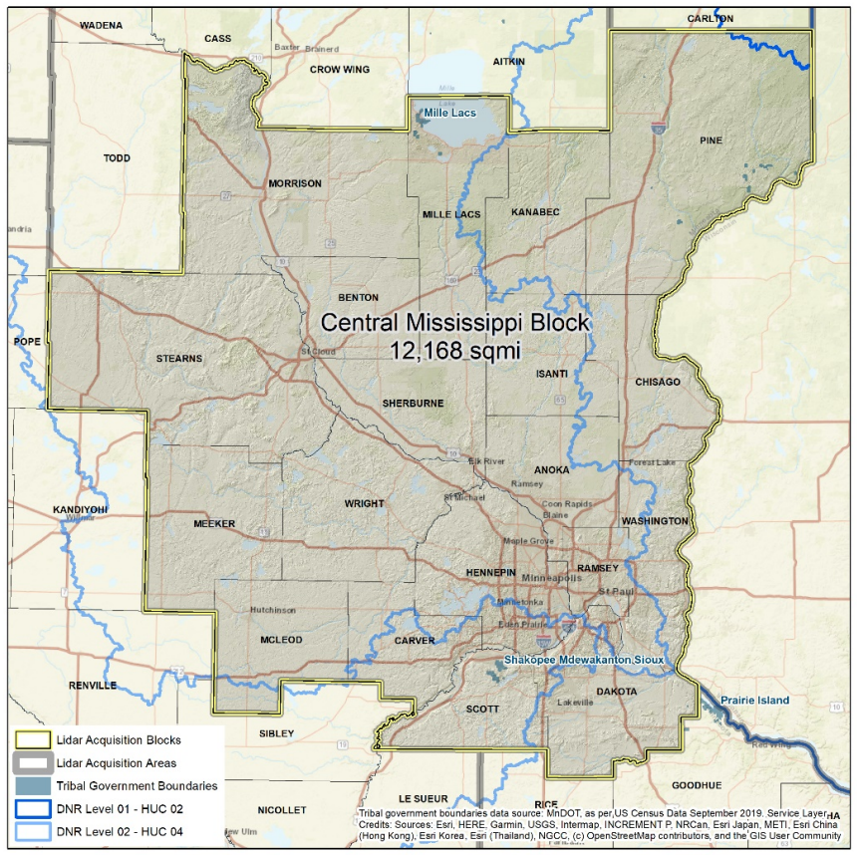
LIDAR Project Update
Woolpert has collected the
Metro region as part of the
Central Mississippi Region
(18 Counties)
Preliminary data is at USGS
Delivery od data to counties
sometime in Spring 2023

Slide 14
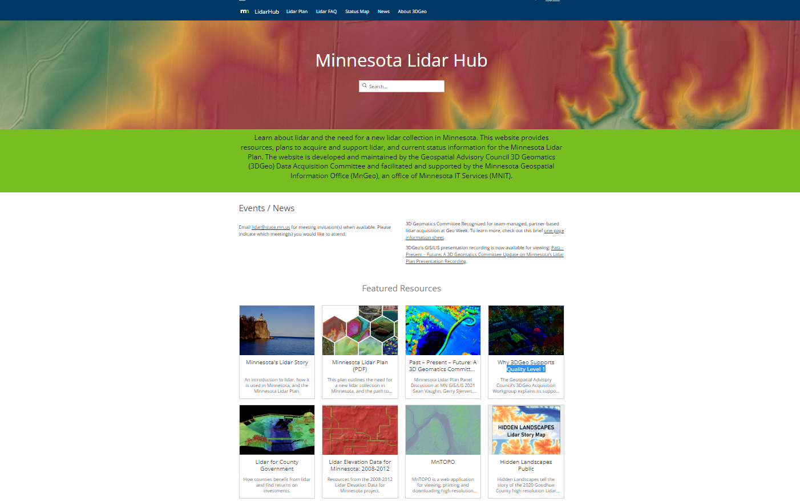
https://lidarhub-minnesota.hub.arcgis.com/

Slide 15
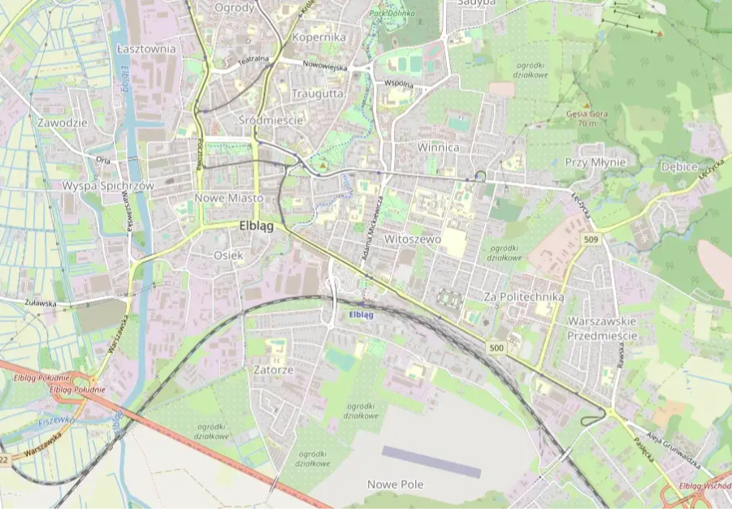
External Platform Publishing
Metro regional datasets available to/integrated with/published in:
ESRI Community Basemap
Google Maps
Open Street Map
HERE

Slide 16
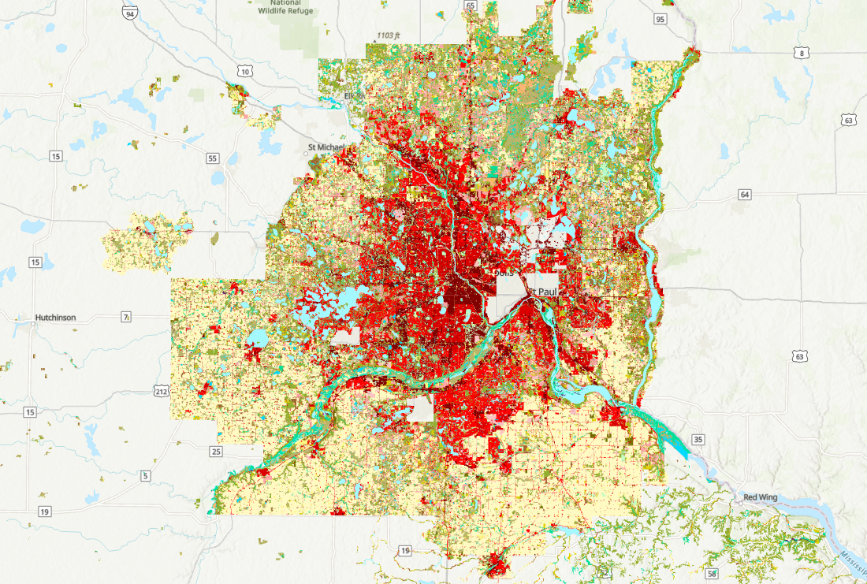
MLCCS Project
(Minnesota Land Cover Classification System)
Existing MLCCS data is from 2011
Metro region data is incomplete
MetroGIS providing $26,500 in 2023 toward
new land cover data collection process

Slide 17
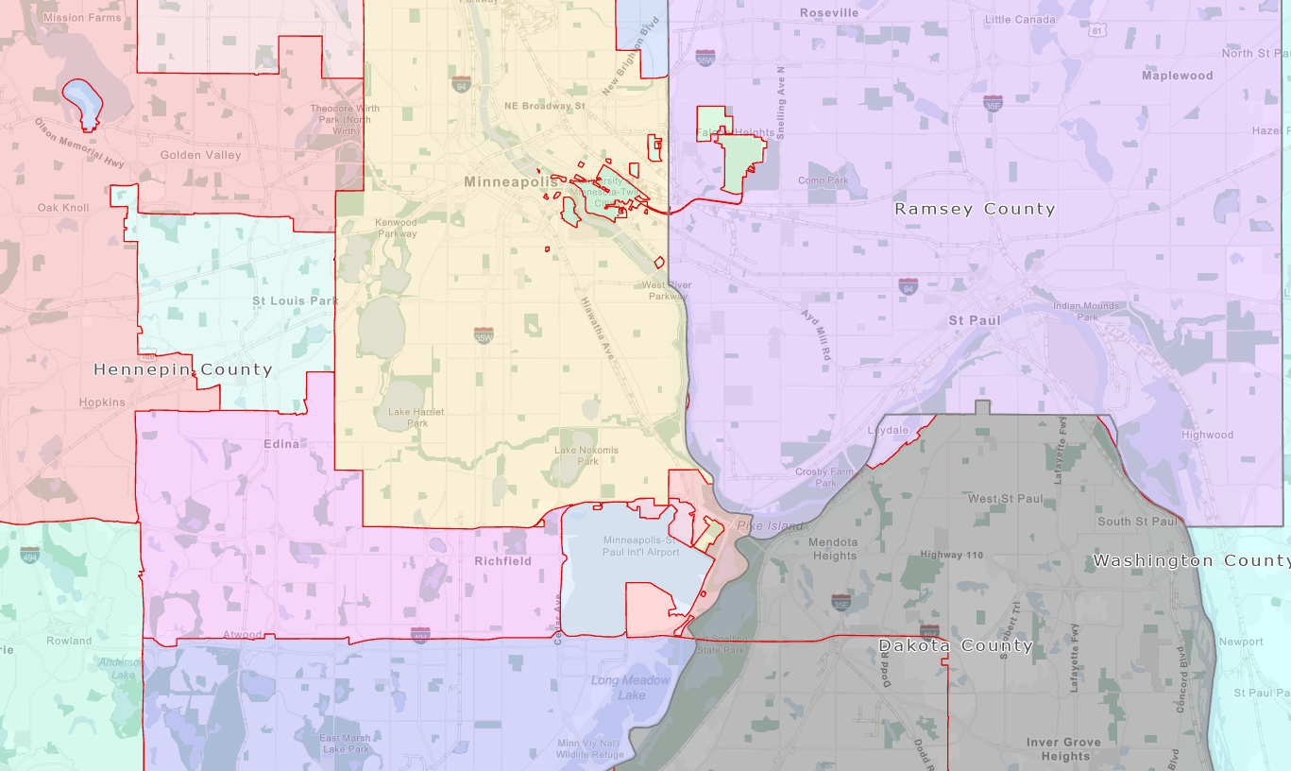
GIS Data Provisioning for NG9-1-1
Re-think as regional data provisioning with
NG9-1-1 as primary use case
Documentation of existing methods and processes for regional data maintenance
Best practices for accuracy and consistency of data
General data life-cycle models
(i. e., the workflow and process of the creation of new address or street to its appearance and maintenance in the data…)

Slide 18
6 ) Lightning Round
7 ) Adjourn

